Slide 1
Capstone Project
Aaron Tu

Slide 2
Project Overview
Financial Markets is notoriously difficult to predict
Tracking systemic liquidity: flow of capital and credit within the global financial system
Seasonal aspect based on Federal reserve and US treasury operations
Forecast future interest rates via 10 year US Treasury bonds and related assets

Slide 3
Proposed Vision
-Regression Analysis
Stationary vs non-stationary base linear regression
Bayesian Ridge
-Decision Trees
Hidden markov chains
Chi-square
Reduction in variance

Slide 4
Potential Impact
Being able to understand the cyclical nature of liquidity within the US financial system
Strategically leveraging the current condition in your own business.
Example, it could be deciding whether or not to raise capital through debt, expanding or winding down operations, purchasing or selling risk assets, hedging for tail risk

Slide 5
Datasets
Money and credit between private entities:
Consumer credit https://fred.stlouisfed.org/series/TOTALSL
M0 https://fred.stlouisfed.org/series/BOGMBASE
M1 https://fred.stlouisfed.org/series/M1SL
M2 https://fred.stlouisfed.org/series/WM2NS
M3 https://fred.stlouisfed.org/series/MABMM301USM189S
Credit: https://fred.stlouisfed.org/series/FDHBPIN
Money and credit between public entities:
Bank credit, all commercial banks https://fred.stlouisfed.org/series/TOTBKCR
Dollars in circulation, domestic https://fred.stlouisfed.org/series/CURRCIR
Deposits, all commercial banks https://fred.stlouisfed.org/series/DPSACBW027SBOG
Fed Funds Rate https://fred.stlouisfed.org/series/EFFR
Fed/US Treasury:
Reverse repo https://fred.stlouisfed.org/series/RRPONTSYD
Treasury General Account https://fred.stlouisfed.org/series/WTREGEN
System Open Market Account https://fiscaldata.treasury.gov/datasets/daily-treasury-statement/operating-cash-balance
Notes:
Money and credit via private liquidity
Consumer credit https://fred.stlouisfed.org/series/TOTALSL
M0 https://fred.stlouisfed.org/series/BOGMBASE
M1 https://fred.stlouisfed.org/series/M1SL
M2 https://fred.stlouisfed.org/series/WM2NS
M3 https://fred.stlouisfed.org/series/MABMM301USM189S
Credit: https://fred.stlouisfed.org/series/FDHBPIN
Money and credit between public entities:
Bank credit, all comercial banks https://fred.stlouisfed.org/series/TOTBKCR
Dollars in circulation, domestic https://fred.stlouisfed.org/series/CURRCIR
Deposits, all commercial banks https://fred.stlouisfed.org/series/DPSACBW027SBOG
Fed Funds Rate https://fred.stlouisfed.org/series/EFFR
Fed/US Treasury:
Reverse repo https://fred.stlouisfed.org/series/RRPONTSYD
Treasury General Account https://fred.stlouisfed.org/series/WTREGEN
System Open Market Account https://fiscaldata.treasury.gov/datasets/daily-treasury-statement/operating-cash-balance

Slide 6
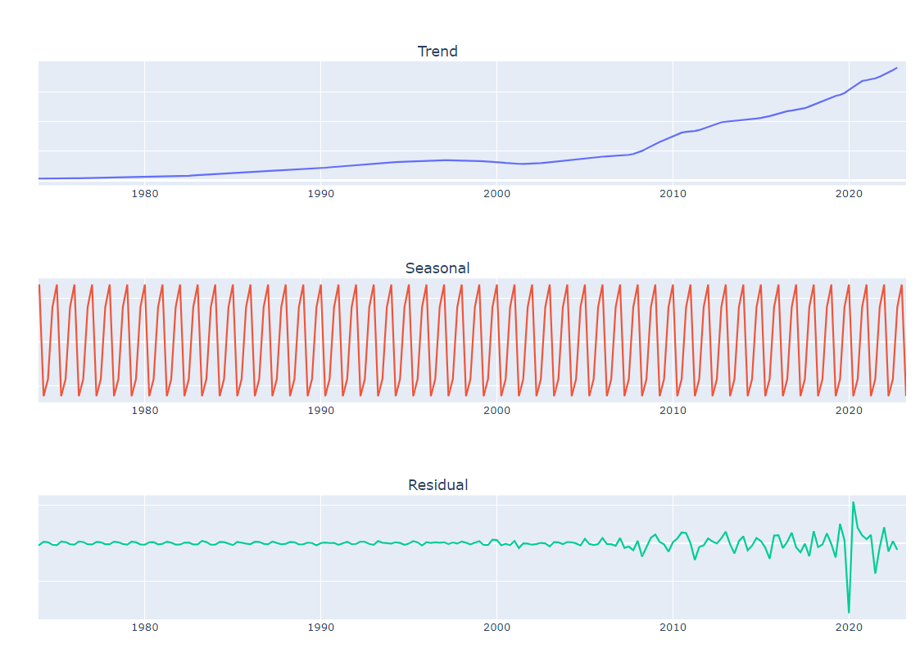
Exploratory Data Analysis
Majority of liquidity measures are running totals
Non stationary
Example:
- Federal debt of private investors steadily increasing in a debt based monetary system

Slide 7
Next Steps
Continue with data preprocessing
Detrend the time series data to get workable stationary data for modelling
Combining all relevant public and private variables
Splitting the time series for evaluation, how do we determine the best time frames for fitting and evaluation?
Questions to ask:
Which machine learning algorithm will produce better estimates for the US 10 Year bond?
Which independent variables will be the best predictor, private or public?

